Slide 1
Car Accidents Data Analysis
UK Government data, 2005-2015
Dataset Found at: https://www.data.gov.uk/dataset/c0eec478-ef19-4234-826f-8efb9563eda2/road-safety
Github: https://github.com/HabibR101/Project_1

Slide 2
Cleaning and narrowing down of data
Over 2 million data points
Data cleaned by the following local authority areas:
300 Birmingham
302 Coventry
303 Dudley
305 Sandwell
306 Solihull
307 Walsall
309 Wolverhampton
Merged on ‘accident_index’ as this column had matched values across all 3 csv files

Slide 3
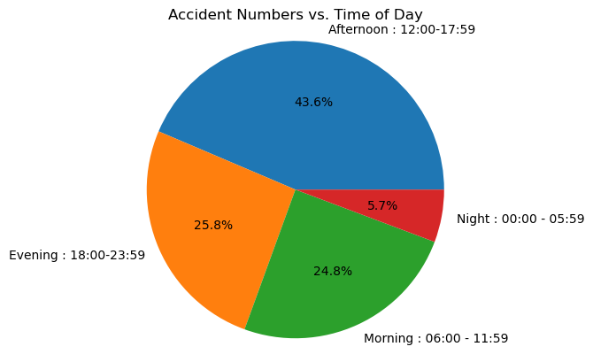
Analysis of Casualty Severities vs Time of Day- Jo
Question: When are accidents most likely to occur, based on time of day?
Filtered the data by combining accidents that have occurred during specific times of day into intervals, such that we can better assess when accidents are most likely to occur.
Morning - 06:00 - 11:59
Afternoon - 12:00 - 17:59
Evening- 18:00-23:59
Night- 00:00 - 05:59

Slide 4
Analysis of Casualty Severities vs Light Conditions- Jo
Question: What type of light conditions contribute to the severity of casualties?
In the government data file, the road safety key has defined values in column 'Light_Conditions' with the below keys-
1 : Daylight
4 : Darkness - lights lit
5 : Darkness - lights unlit
6 : Darkness - no lighting
7 : Darkness - lighting unknown
-1 : Data missing or out of range
It has also defined defined values in column 'Casualty_Severity' with the below keys--
1 : Fatal
2 : Serious
3 : Slight
We combined the data under key 5 and 6, as both involved the roads being unlit. We will be dropping the data points from key 7 and -1 as this could potentially skew or create bias in our data because we do not know if the roads were lit or not.

Slide 5
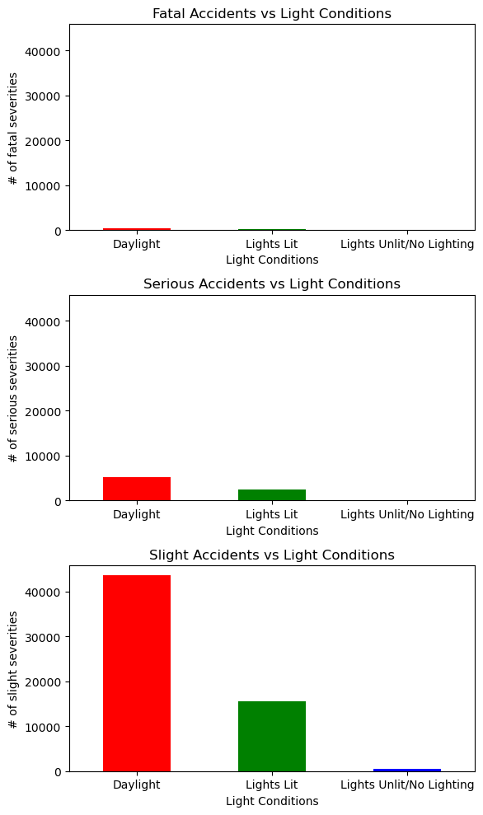
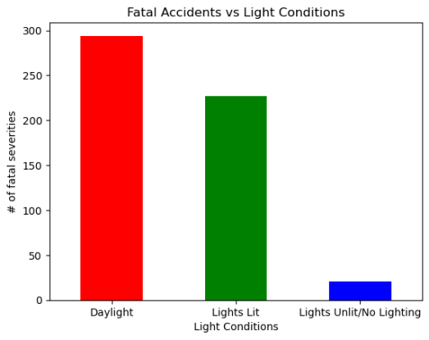
Analysis of Casualty Severities vs Light Conditions- Jo
Majority of accidents, happen during daylight hours – so what could be the reason for this?

Slide 6
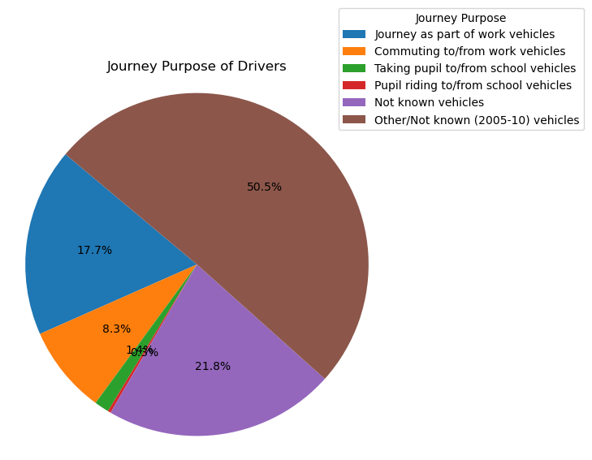
Journey Purposes- Jo
Question: why are most accidents happening in the daylight, then?
From the above bar plots, one can clearly see that accidents are happening when the roads are lit with daylight. This seems strange so we thought we would investigate this further. We wanted to see what the journey purpose was, as if most people are having accidents in the daylight hours, we would expect them to be doing school runs, work commutes etc.
The government data key shows the following, for values in column **'Journey_Purpose_of_Driver'**:
1 : Journey as part of work vehicles
2 : Commuting to/from work vehicles
3 : Taking pupil to/from school vehicles
4 : Pupil riding to/from school vehicles
5 : Other vehicles
6 : Not known vehicles
15 : Other/Not known (2005-10) vehicles
-1 : Data missing or out of range vehicles

Slide 7
Analysing Distribution of Accidents by their ‘Severity Levels’ - Maliha
Data Preparation:
Utilized Pandas DataFrames to merge 'Accident Severity' and 'Years' columns for decade-wise analysis.
Filtering:
Applied conditional logic to filter data for specific accident severities (Fatal, Serious, Slight) within a five-year timeframe.
Data Exploration:
Employed sorting and grouping techniques to gain deeper insights into the dataset.
Visualization:
Matplotlib has been used to create various graphical representations:
Pie Charts: Used to depict the distribution of accident severities.
Bar Graphs: Visualized the frequency of accidents based on different parameters.
Line Charts: Utilized for trend analysis and visualizing changes over time.

Slide 8
Accident Severity Levels- Maliha
There are three different Severity levels in our data set:
Fatal: killed
Serious: Broken neck or back, Severe chest injury, any difficulty breathing, Loss of arm or leg (or part),
Severe head injury, unconscious…
Slight: Whiplash or neck pain, Sprains and strains, Bruising, Shock

Slide 9
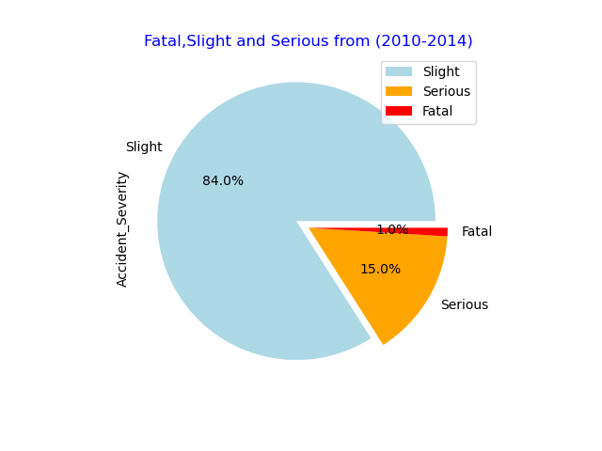
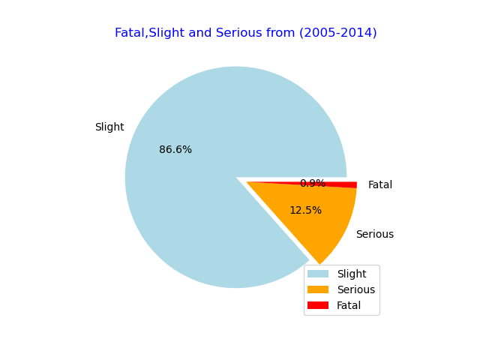
Pie charts showing the distribution of Accident Severities (Fatal, Slight, Serious) - Maliha
Accident Severity Levels from 2005 to 2014
Accident Severity Levels From 2010 to 2014

Slide 10
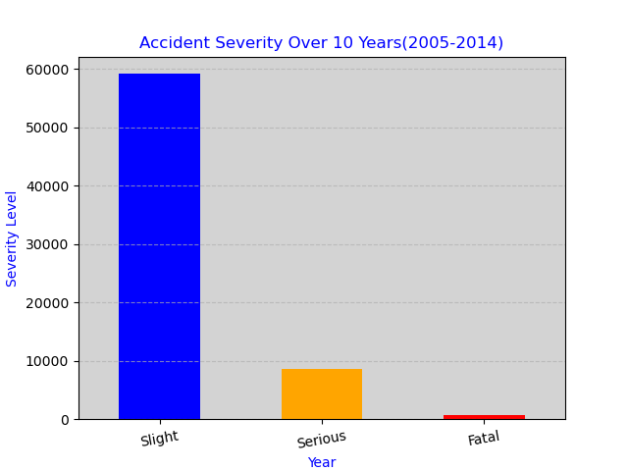
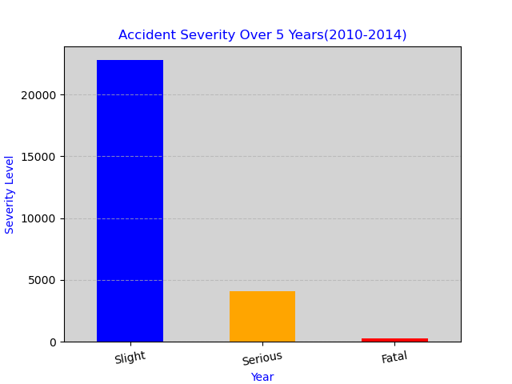
Bar charts showing the distribution of Accident Severities (Fatal, Slight, Serious)
Accident Severity Levels from 2005 to 2014
Accident Severity Levels from 2010 to 2014

Slide 11
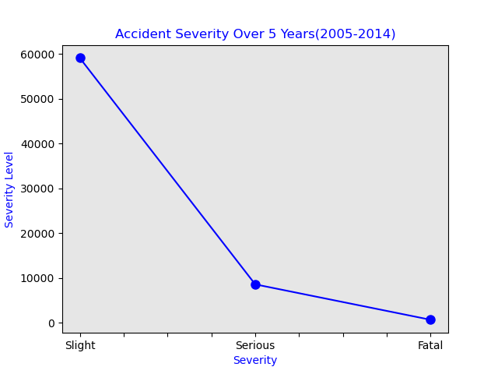
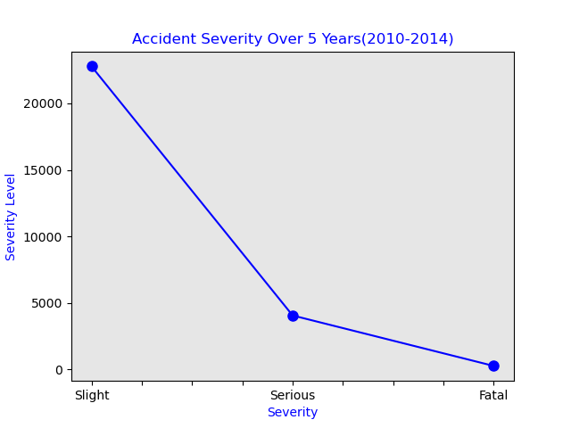
Line charts showing the distribution of Accident Severities (Fatal, Slight, Serious) - Maliha
Accident Severity Levels from 2005 to 2014
Accident Severity Levels from 2005 to 2014

Slide 12
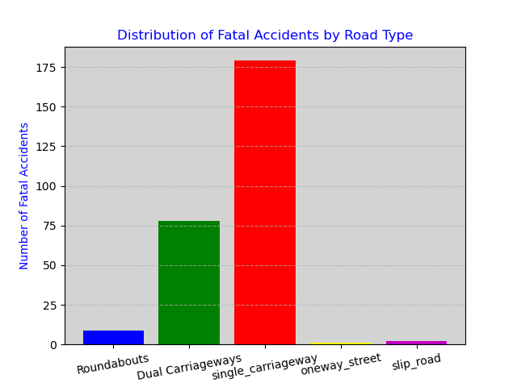
Distribution of Fatal Accidents by Road Type- Maliha

Slide 13
Interpretation of ‘Fatal’ Accidents by Road Type- Maliha
Single Carriageway:
The highest number of fatal accidents occurred on Single Carriageway compared to other road types.
Single Carriageway have the highest risk of fatal accidents among the specified road types.
Travel on single carriageways is several times more risky than on dual carriageways.
Dual Carriageways:
Dual carriageways experienced a significant number of fatal accidents, but it is lower than Single Carriageway.
It's the second-highest contributor to fatal accidents.
Roundabouts:
Roundabouts have a lower number of fatal accidents compared to single_carriageway and dual carriageways.
They pose a relatively lower risk of fatal accidents.
One-way Streets: & Slip Roads:
One-way streets have a very low number of fatal accidents.
They are the safest among the specified road types. Slip roads have the lowest number of fatal accidents.
They are the least risky among the specified road types.

Slide 14
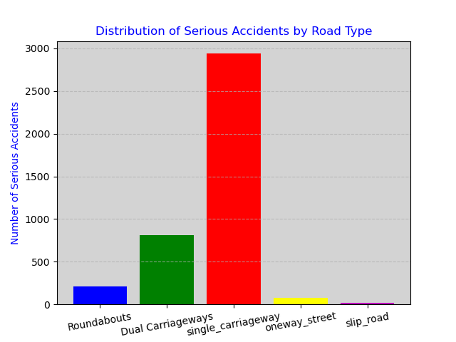
Distribution of Serious Accidents by Road Type - Maliha

Slide 15
Distribution of Serious Accidents by Road Type - Maliha
Single Carriageway:
Single Carriageway of road has the highest number of serious accidents. This indicates that single carriageway roads may be associated with a higher risk of serious accidents compared to other road types.
Dual Carriageway: Dual carriageways have a relatively lower number of serious accidents compared to single carriageways. This suggests that dual carriageways may be comparatively safer in terms of serious accidents.
Roundabouts: Roundabouts have a moderate number of serious accidents. While they are safer than single carriageways, they still pose a significant risk compared to dual carriageways.
One-way Streets and Slip Roads: These road types have the lowest number of serious accidents. This indicates that these types of roads may be relatively safer in terms of serious accidents.

Slide 16
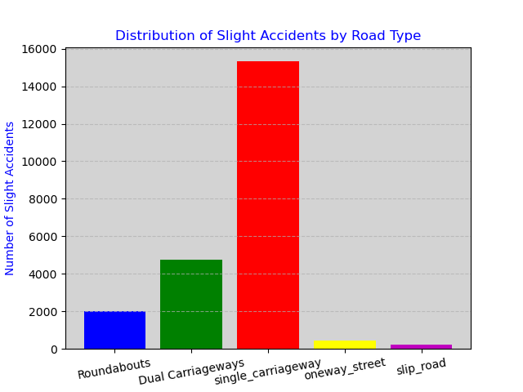
Distribution of Slight Accidents by Road Type - Maliha

Slide 17
Distribution of ‘Slight’ Accidents by Road Type - Maliha
Single Carriageway:
This type of road has the highest number of slight accidents. This indicates that single carriageway roads may be associated with a higher risk of slight accidents compared to other road types.
Roundabouts:
Roundabouts have a relatively moderate number of slight accidents. They are safer than single carriageways but still pose a significant risk.
Dual Carriageway:
Dual carriageways have a lower number of slight accidents compared to single carriageways. This suggests that dual carriageways may be comparatively safer in terms of slight accidents.
One-way Streets and Slip Roads:
These road types have the lowest number of slight accidents. This indicates that these types of roads may be relatively safer in terms of slight accidents.

Slide 18
Further Inferences
According to the Eastern Daily press:
AA president Edmund King said: 'Most drivers assume that motorways or dual carriageways are the most dangerous roads due to the higher speed of traffic.
This report clearly dispels that myth as the risk to road-users is now seven times greater on single-carriageway A-roads than motorways. Drivers need to be aware of the added risks and adapt their driving accordingly.
Overall, this analysis highlights the importance of considering road type when assessing the risk of Fatal, Slight, Serious slight accidents. It also suggests that measures to enhance safety on single carriageway roads may be particularly important.

Slide 19
Further Inferences
“Vehicle Types vs. Accident Severity”
Objectives:
The data analysis aims to explore and understand the relationship between the types of vehicles involved in road accidents and the severity of the accidents.
The primary objectives of this slides are as follows:
Exploring the dataset to comprehend its structure and quality.
Formulated research questions and focusing on the impact of vehicles types on accident severity.
We made use of python, pandas and matplotlib to conduct data analysis, including statistical method to uncover the patterns within the data set.
We also used visualizations such as bar charts, and pie chats to communicate our findings and highlight any relationships or trends.

Slide 20
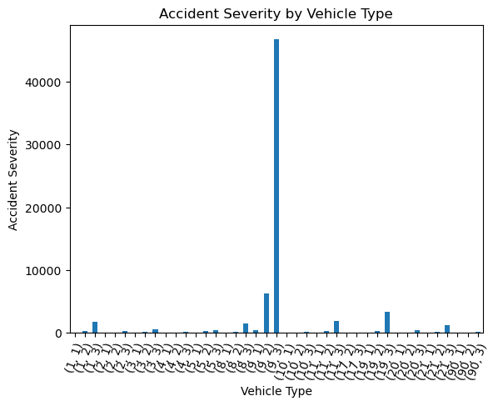
Bar charts showing the vehicle types and Accident severity
1: 'Pedal cycle',
2:'Motorcycle 50cc and under',
3:'Motorcycle 125cc and under',
4:'Motorcycle over 125cc and up to 500cc',
5:'Motorcycle over 500cc',
8:'Taxi/Private hire car',
9:'Car',
10:'Minibus (8 - 16 passenger seats)',
11:'Bus or coach (17 or more pass seats)',
16:'Ridden horse',
17:'Agricultural vehicle',
18:'Tram',
19:'Van / Goods 3.5 tonnes mgw or under',
20:'Goods over 3.5t. and under 7.5t',
21:'Goods 7.5 tonnes mgw and over',
22:'Mobility scooter',
23:'ElecElectric motorcycle',
90:'Other vehicle',
97:'Motorcycle - unknown cc',
98:'Goods vehicle - unknown weight',
-1:'Data missing or out of range',

Slide 21
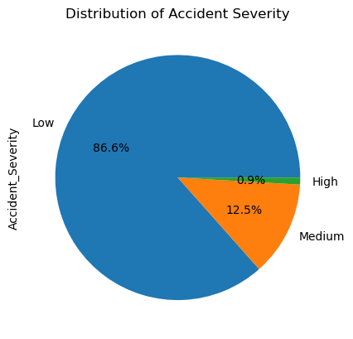
Pie chart showing the distribution of Accident Severity
(High, Medium, Low)

Slide 22
Conclusion
Based on the analysis that has been conducted in this project, we can answer the main research question:
“Does they type of vehicle involved in an accident impact the severity of the accident?”
Answer :Yes, the type of vehicle involved in an accident does impact the severity of the accident, we could see in both our bar chart and pie chart that there was a noticeable difference in accident severity based on the type of vehicle involved, and also number of vehicles involved also plays a role in accident severity. Multiple-vehicle collisions were more likely to result in high-severity accidents compared to single-vehicle incidents.

